Slide 1
Progress and Pitfalls With Diagnosis in Peripheral T-Cell Lymphoma (PTCL)
Pier Paolo Piccaluga, MD, PhD
Department of Experimental, Diagnostic, and Specialty Medicine University of Bologna Medical School
Bologna, Italy

Slide 2
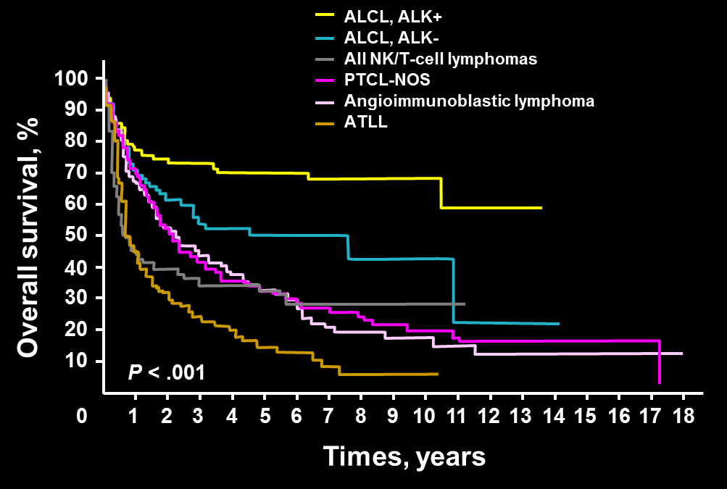
Peripheral T-Cell Lymphomas
Rare tumors (10% NHL)
Heterogeneous
No diagnostic markers (but ALK⁺)
Genetics
RHOA, TET2, IDH2, DNMT3A/B
t(2;5), t(5;9), t(6;9) ….
Poor outcome
Vose J, et al. J Clin Oncol. 2008;26(25):4124-4130.

Slide 3

Can Molecular Diagnostic Improve Our Ability?

Slide 4
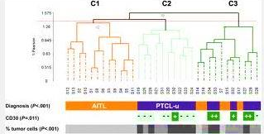
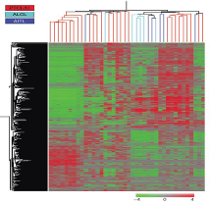
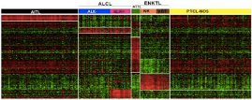
GEP Identified Specific Signatures for PTCLs/NOS, AITL and ALCLs
VEGF
VEGFR
de Leval L, et al. Blood. 2007;109(11):4952-4963. Piccaluga PP, et al. J Clin Invest. 2007;117(3):823-834.
Piccaluga PP, et al. Cancer Res. 2007;67(22):10703-10710. Piva R, et al. J Clin Oncol. 2010;28(9):1583-1590.

Slide 5

Molecular Profiling Improves Classification and Prognostication of Nodal Peripheral T-cell Lymphomas: Results of a Phase III Diagnostic Accuracy Study.
Entities at histology:
PTCL/NOS
AITL
ALCL ALK-
Molecularly defined entities
84% concordance for AITL
95% concordance for ALCL ALK-
Piccaluga PP et al, JCO 2013

Slide 6
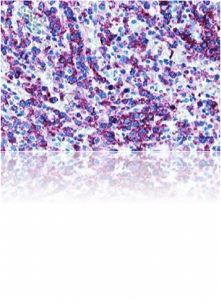
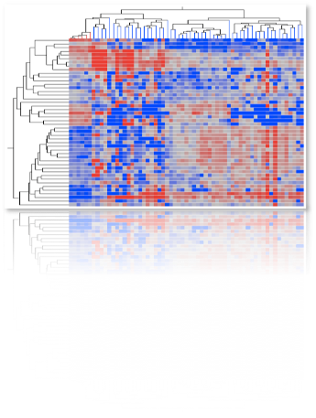
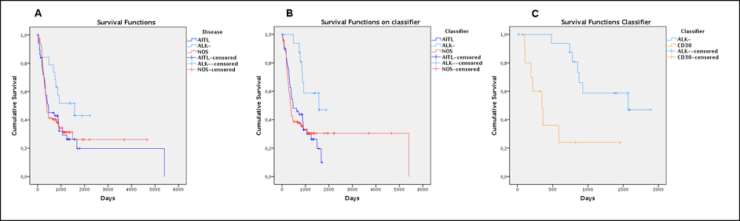
Molecular Profiling Improves Classification and Prognostication of Nodal Peripheral T-Cell Lymphomas: Results of a Phase III Diagnostic Accuracy Study
VS
P = .62
P = .011
P = .02
Conventional Histopathology
Molecular Classifier
Molecular Classifier
Piccaluga PP, et al. J Clin Oncol. 2013;31(24):3019-3025.

Slide 7
Gene Expression Signatures Delineate Biological and Prognostic Subgroups in Peripheral T-Cell Lymphomas
Iqbal J, et al. Blood. 2014;123(19):2915-2923.

Slide 8
Gene Expression Signatures Delineate Biological and Prognostic Subgroups in Peripheral T-Cell Lymphomas
Iqbal J, et al. Blood. 2014;123(19):2915-2923.

Slide 9
Gene Expression Signatures Delineate Biological and Prognostic Subgroups in Peripheral T-Cell Lymphomas
Iqbal J, et al. Blood. 2014;123(19):2915-2923.

Slide 10
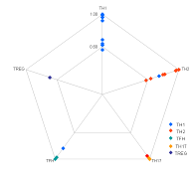
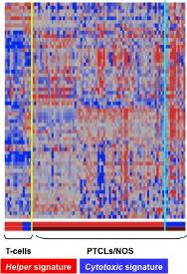
Classification of PTCLs-NOS According to Their Cellular Counterpart
Survival Functions
Cumulative Survival
1.0
Groups
TC
TFH-TREG
TH1_2_17
0.8
Morphological
PTCL-NOS
diagnosis
0.6
Phenotypic
Molecular
0.4
0.2
Molecular
Helper
profile
Cytotoxic
profile
0.0
0
20.00
40.00
60.00
100.00
Months
80.00
Survival Functions
Cumulative Survival
1.0
Groups
TC
TH1_TH2
TREG_TFH
Treg-Tfh
0.8
Molecular or
Phenotypic
0.6
Non-Treg/Tfh
0.4
0.2
0.0
0
20.00
40.00
60.00
Months
80.00
100.00
Piccaluga PP, et al [in preparation]

Slide 11
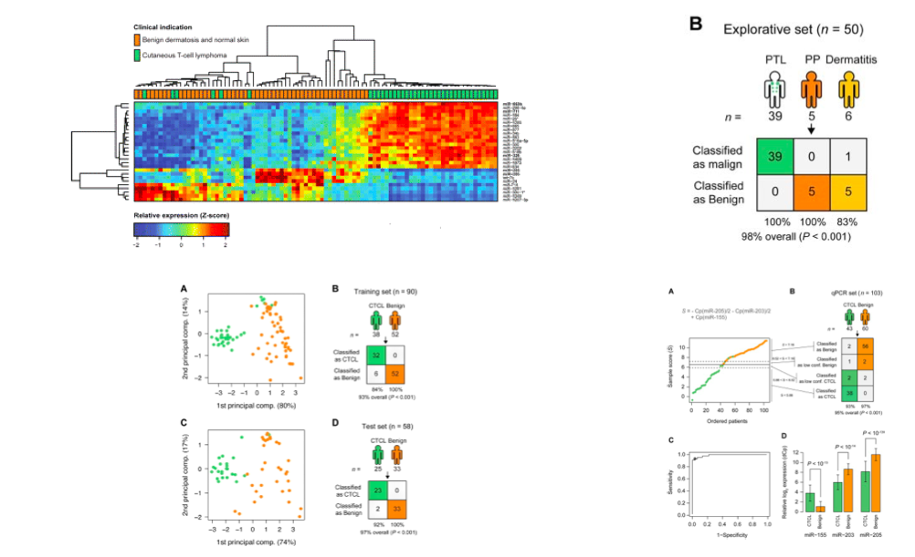
Diagnostic MicroRNA Profiling in Cutaneous T-Cell Lymphoma (CTCL)
Ralfkiaer U, et al. Blood. 2011;118(22):5891-5900.

Slide 12
Pathogenetic and Diagnostic Significance of MicroRNA Deregulation in Peripheral T-Cell Lymphoma Not Otherwise Specified
STEP 1
T-test P value <.05; foldchange >2
FDR Bonferroni Correction
PTCL-NOS vs AITL
38 differentially expressed
miRNAs
PTCL-NOS vs ALCL/ALK-
68 differentially expressed
miRNAs
ALCL/ALK- vs ALCL/ALK+
136 differentially expressed
miRNAs
STEP 2
Discriminant analysis for classification
PTCL-NOS vs AITL
8 miRNAs
STEP 2
Discriminant analysis for classification
PTCL-NOS vs ALCL/ALK-
5 miRNAs
STEP 2
Discriminant analysis for classification
ALCL/ALK- vs ALCL/ALK+
4 miRNAs
Laginestra MA, et al. Blood Cancer J. 2014;4:259.

Slide 13
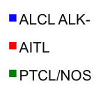
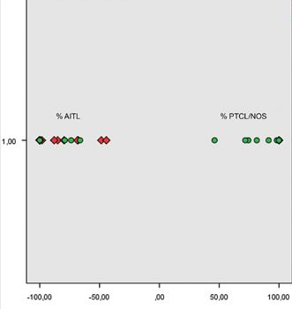
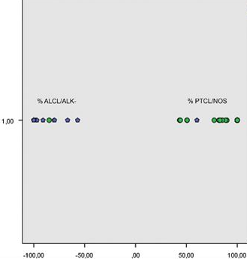
Pathogenetic and Diagnostic Significance of MicroRNA Deregulation in Peripheral T-Cell Lymphoma Not Otherwise Specified
Laginestra MA, et al. Blood Cancer J. 2014;4:259.

Slide 14
Pathogenetic and Diagnostic Significance of MicroRNA Deregulation in Peripheral T-Cell Lymphoma Not Otherwise Specified
Diagnostic accuracy of PTCL-NOS vs AITL and PTCL-NOS vs ALCL/ALK-miRNA classifier evaluated in an independent set of cases
Survival Functions
miRNA classification
Histopathology
Total
Cumulative Survival
1.0
Classification Group
AITL
ALCL ALK-
ALCL ALK+
PTCL-NOS
PTCL-NOS
AITL
0.8
PTCL-NOS
AITL
15
4
5
16
20
20
0.6
Accuracy
0.4
Value
95% CI
ST
SP
PPV
NPV
LR+
LR-
0.762
0.789
0.8
0.75
3.619
0.302
0.549-0.894
0.567-0.915
0.584-0.919
0.531-0.888
1.467-8.928
0.136-0.671
0.2
0.0
0
1000
2000
3000
4000
Overall accuracy 77.5% (31 of 40)
Days
miRNA classification
Histopathology
Total
Survival Functions
Classification Group
ALCL ALK-
NOS_CD30+
Cumulative Survival
1.0
PTCL-NOS
ALCL/ALK-
PTCL-NOS
ALCL/ALK-
17
1
3
18
20
19
0.8
Accuracy
0.6
Value
95% CI
0.4
ST
SP
PPV
NPV
LR+
LR-
0.857
0.944
0.947
0.85
15.429
0.151
0.654-0.95
0.742-0.999
0.754-0.991
0.64-0.948
2.278-104.475
0.053-0.434
0.2
0.0
Overall accuracy 89.74% (35 of 39)
0
1000
2000
3000
4000
Days
Laginestra MA, et al. Blood Cancer J. 2014;4:259.

Slide 15
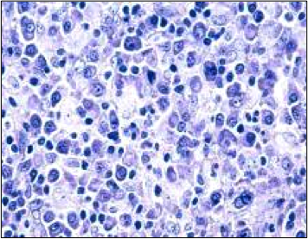
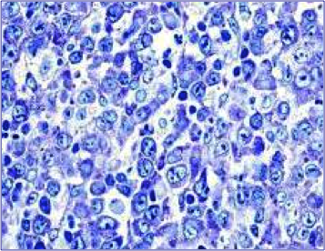
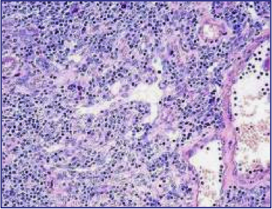
Molecular Diagnostic Can Improve the Distinction of Nodal “Grey Zone” PTCLs
Tfh PTCL/NOS
vs.
AITL
CD30+ PTCL/NOS
vs.
ALK- ALCL

Slide 16
A Fraction of PTCL/NOS Derives from TFH Cells
De Leval L et al. Blood, 2007

Slide 17
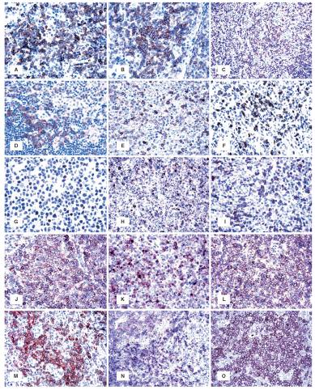
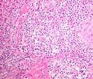
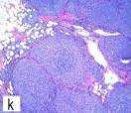
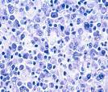
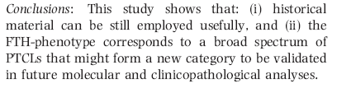
Genetics
TET2
RHOA
IDH2
T(5;9)-ITK/SYK

Slide 18
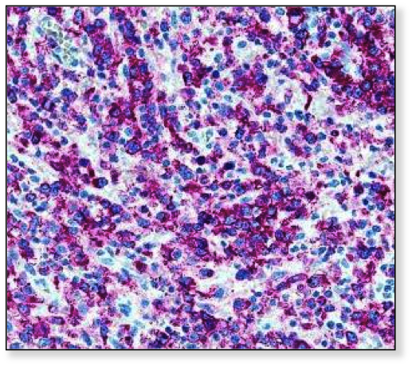
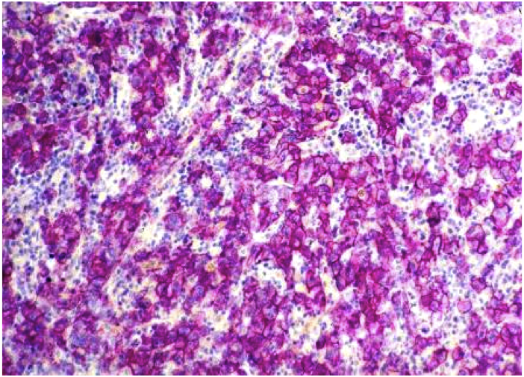
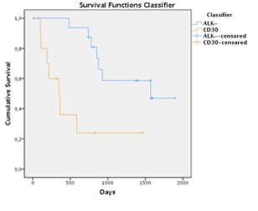
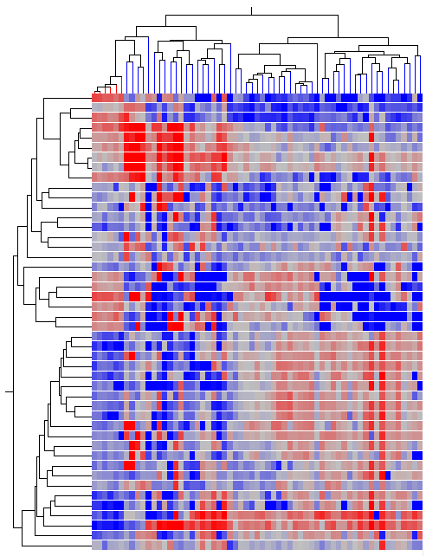
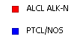

CD30⁺ PTCLs/NOS is different from ALCL
CD30⁺ PTCL/NOS cases
No criteria for ALK- ALCL diagnosis
16 cases
Molecular classifier
16/16→ PTCL/NOS
No ALCL morphology; CD30 > 75%
P=0.02
Discriminant analysis
PTCL/NOS vs. ALK⁻/ALCL → 53 genes
Patent N. 61.U2164.12.IT.34
Molecular Classifier
Piccaluga PP et al. J Clin Oncol. 2013 Aug 20;31(24):3019-3025

Slide 19
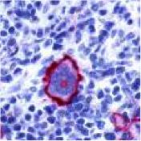
CD30: One Target, More Than One Disease

Slide 20
Current Diagnostic by Anti-CD30 Staining
Hodgkin lymphoma
Anaplastic large cell lymphoma
B-cell lymphomas
PMBCL
DLBCL
Peripheral T-cell lymphomas
CD30⁺ PTCL/NOS

Slide 21
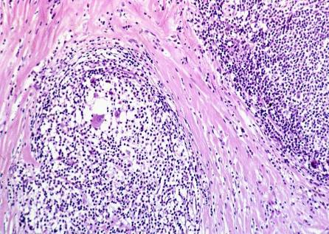
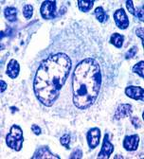
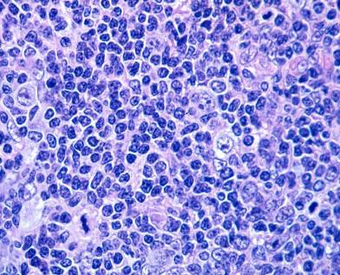
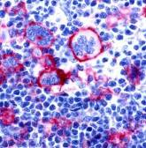
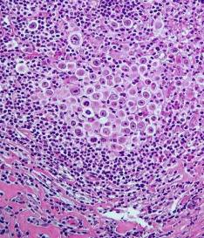
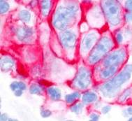
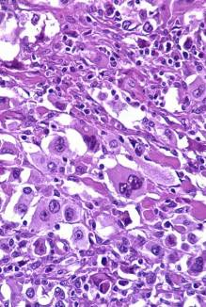
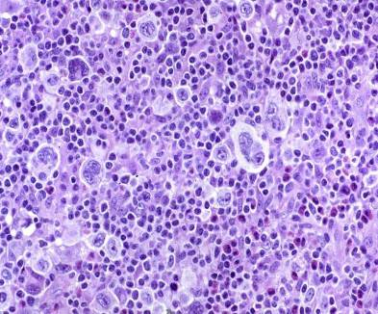
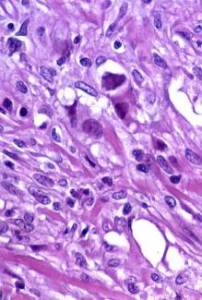
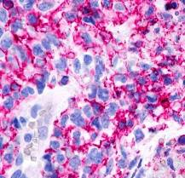
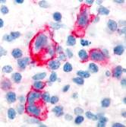
CD30 Expression in cHL
NS II
NS I
LR
LD
S
MC
LD, lymphocyte depletion; LR, lymphocyte rich; MC, mixed cellularity; NS, nodular sclerosis; S, sarcomatoid.

Slide 22
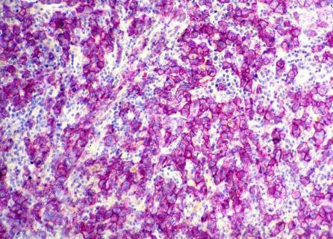
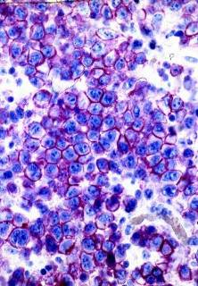
Anaplastic Large Cell Lymphoma
CD30
EMA
Perforin
Phenotype:
CD30⁺
T/null (PAX5⁻)
CD45^{+/-}
EMA^{+/-}
CD15⁻⁽⁺⁾
Cytotoxic markers⁺
EBV⁻
Cutaneous ALCL

Slide 23
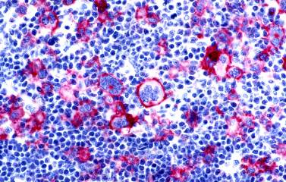
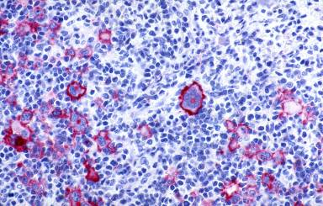
CD30 Expression Is Stable During Disease Natural History
ASCO 2012: Retreatment with brentuximab vedotin in CD30‑positive hematologic malignancies: A phase II study (# 8027)
EHA 2012: Persistence of cd30 expression in CD30-positive lymphomas following treatment with brentuximab vedotin (SGN-35)(# 0203)
Before
After
Bartlett N, et al. J Clin Oncol. 2012;30(15S): Abstract 8027. Nathwani N, et al. Haematologica. 2012;97(Suppl 1): Abstract 0203.

Slide 24
Is CD30 Staining (Always) Reliable?

Slide 25
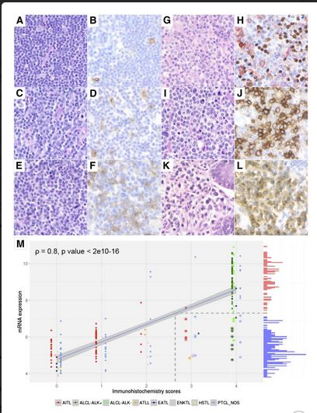
Immunohistochemistry as a Valuable Tool to Assess CD30 Expression in Peripheral T-cell Lymphomas: High Correlation Between Protein and mRNA Expression
Bossard C, et al. Blood. 2014;124(19):2983-2986.

Slide 26
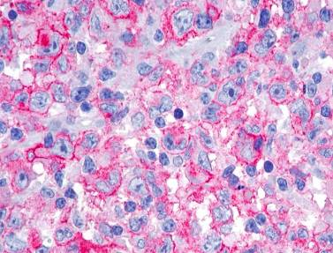
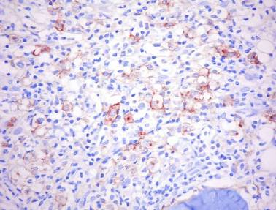
Fixation
10% buffered formalin (Lillie’s) 24h: optimal
Bouin 4-6h: acceptable
B5 2-3h: suboptimal
Formalin-fixed
B5-fixed
Courtesy of Prof. Stefano Pileri

Slide 27
Targeting CD30 in Other CD30+ Hematological Malignancies

Slide 28
Anaplastic DLBCL ≈100%
MZL/LPL 5-20%
PTCLs ≈40%
EBV+ DLBCL of elderly ≈100%
PMBCL ≈85%
CD30 expression in other hematological malignancies
Notes:
Cambia slide: entità con % e figura

Slide 29
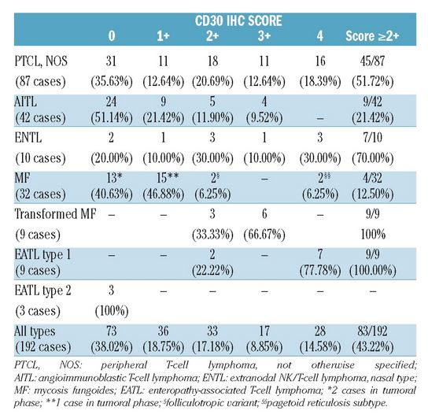
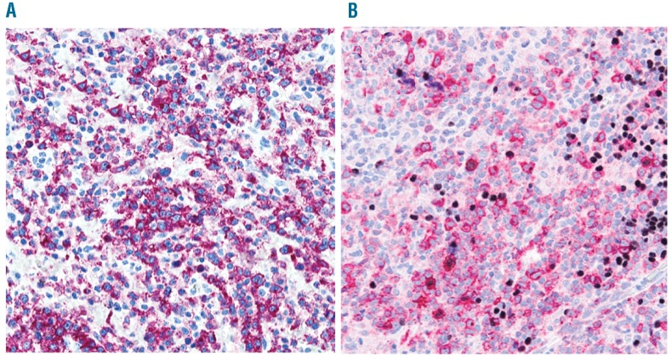
CD30 Expression in T-cell Lymphomas
Sabattini E, et al. Haematologica. 2013;98(8):e81-82.
PTCL-NOS
AITL
0 no staining; 1+ <25% positive cells; 2+ 25–50% positive cells; 3+ >50–75% positive cells; 4+ >75% positive cells

Slide 30
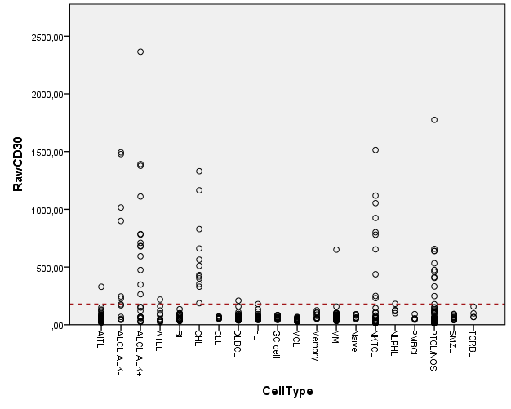
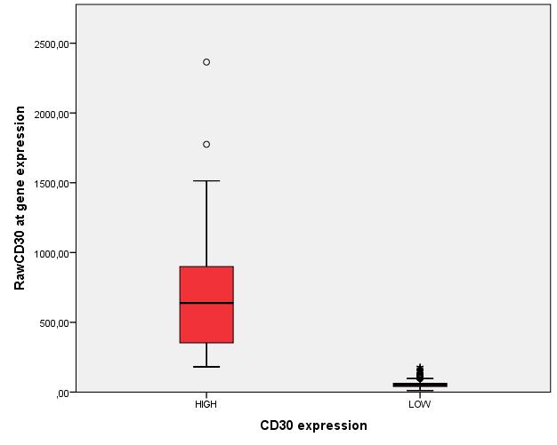
CD30 Expression in Human Lymphomas (N=693)

Slide 31
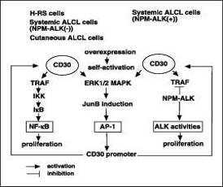

CD30/CD30L Signaling

Slide 32
CD30 Expression is Associated with Cancer-Related Programs in Both B- & T-cell Lymphomas
Antigen Response
Gastric Cancer
Nasopharangyal carcinoma
EGFR Receptor Signaling
CML
Pathways enriched in CD30+ PTCLs
Pathways enriched in CD30+ B-cell lymphomas

Slide 33
CD30 Triggers Common Molecular Events in B- & T-cell Lymphomas
P<.001
4,022
109
578
Genes characterizing CD30+ B-cell lymphomas
Genes characterizing CD30+ T/NK-cell lymphomas

Slide 34
Summary
Molecular diagnostic can improve current standards in PTCL
CD30 is consistently and stably expressed in different PTCL subtypes
CD30 expression is associated with cancer-related pathways in both B- & T-cell lymphomas

